Slide 1
40 YEARS OF INTERVENTIONAL CARDIOLOGY
Michael S. Blanc, FACC, FSCAI
Medical Director
Community Heart and Vascular Center
San Angelo Community Medical Center
San Angelo, TX

Slide 10
Coronary Artery Bypass Surgery
First Surgery performed at the Cleveland Clinic in May 1967 by Dr. Rene Favalaro
By 1970, had performed over 1000 CABG surgeries at Cleveland Clinic

Slide 14
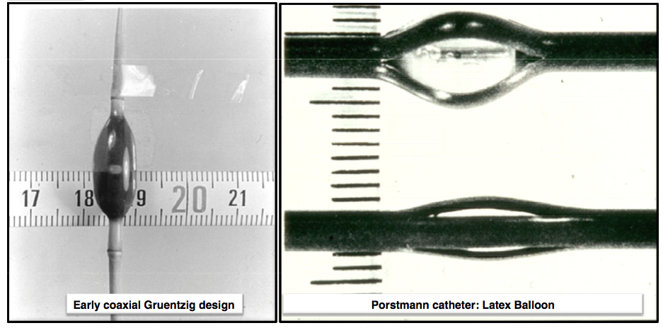

Slide 15
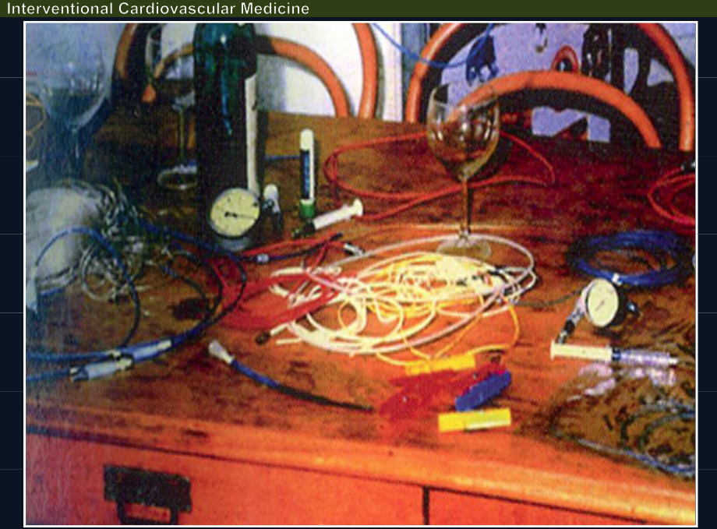

Slide 16
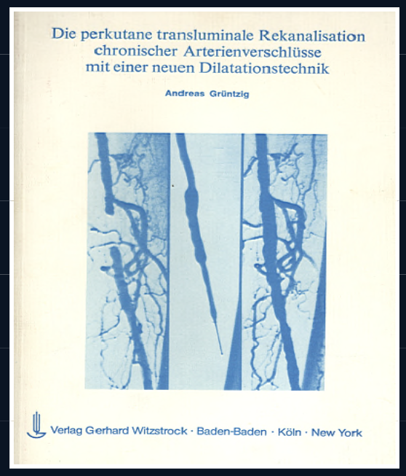

Slide 19
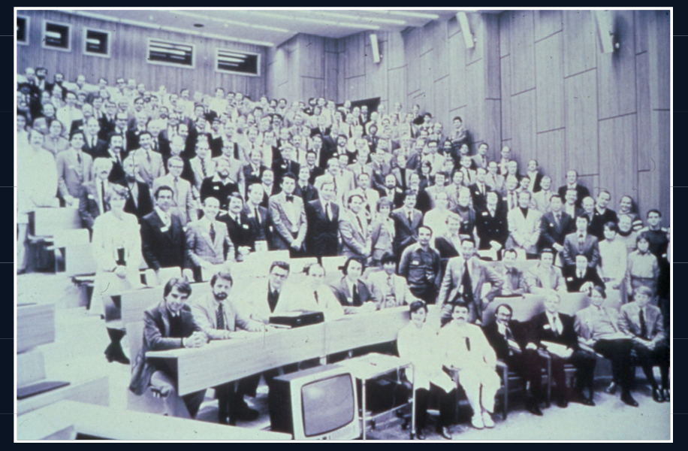

Slide 21
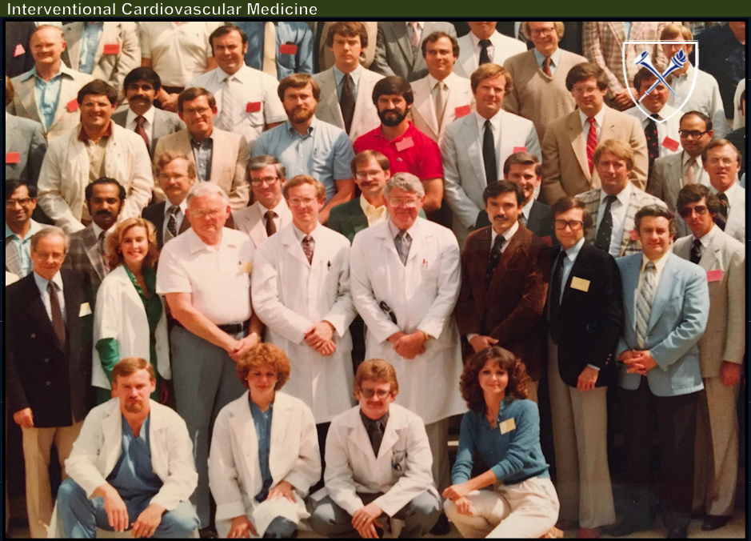

Slide 22
I
4-8% of require
patients ermegency CABG
30-50% restenosis
20°/o
20-30%
Revascularization rate

Slide 27
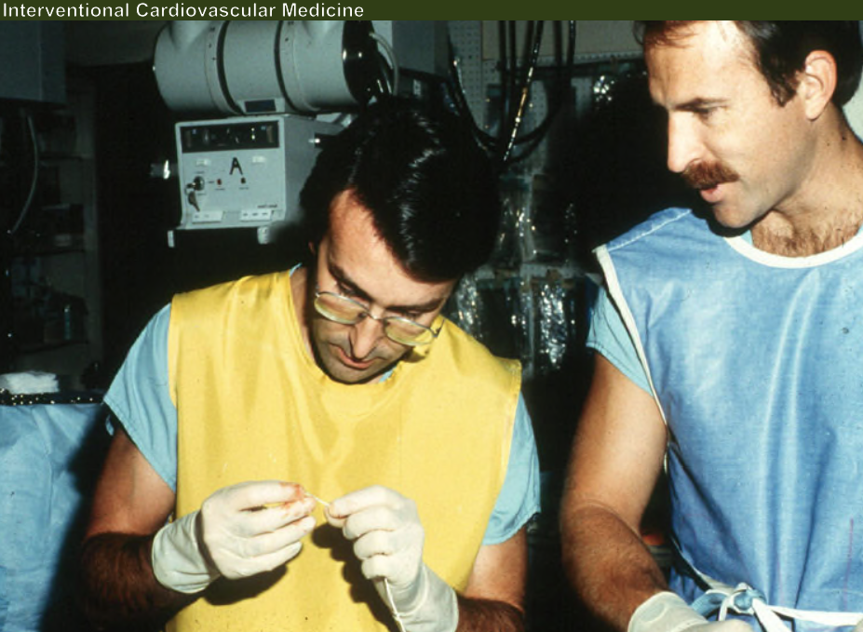

Slide 30
Coronary Stents
Restenosis rates decreased from 35-50% to 15-20%
Acute closure and emergent CABG reduced from 4-8% to <0.5%
By 2000, 85% of PCI involve coronary stenting

Slide 33
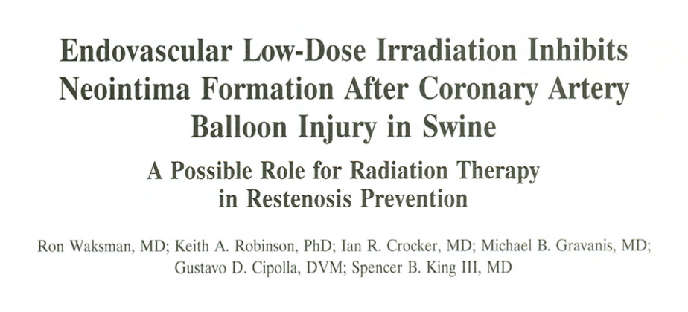

Slide 36
Drug-eluting stents
Introduced in 2004
Cypher/Taxus
Reduce restenosis 20% to 5%

Slide 46
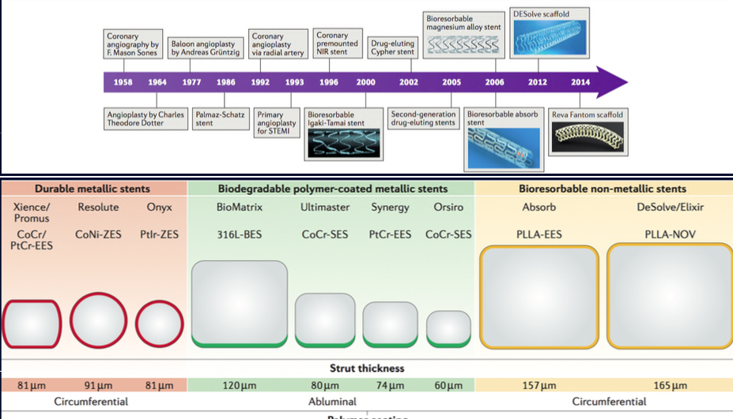

Slide 48
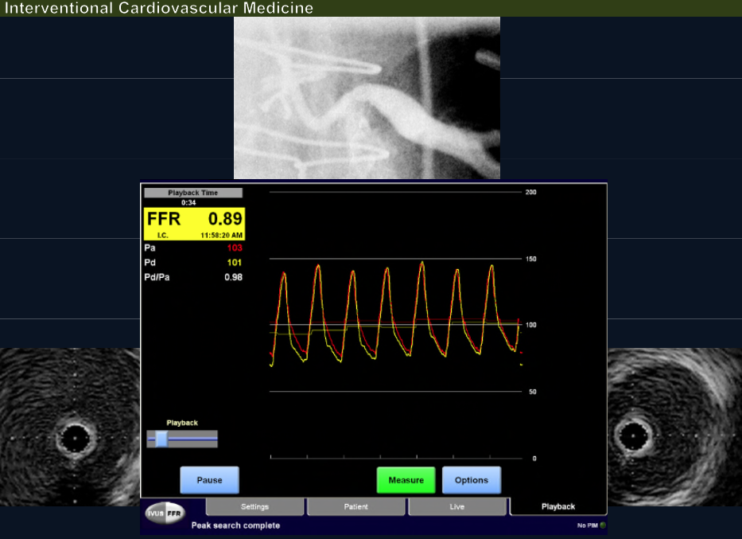

Slide 53
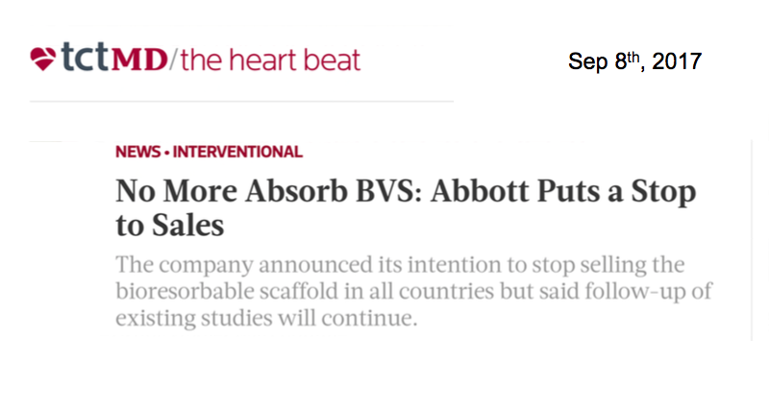

Slide 54
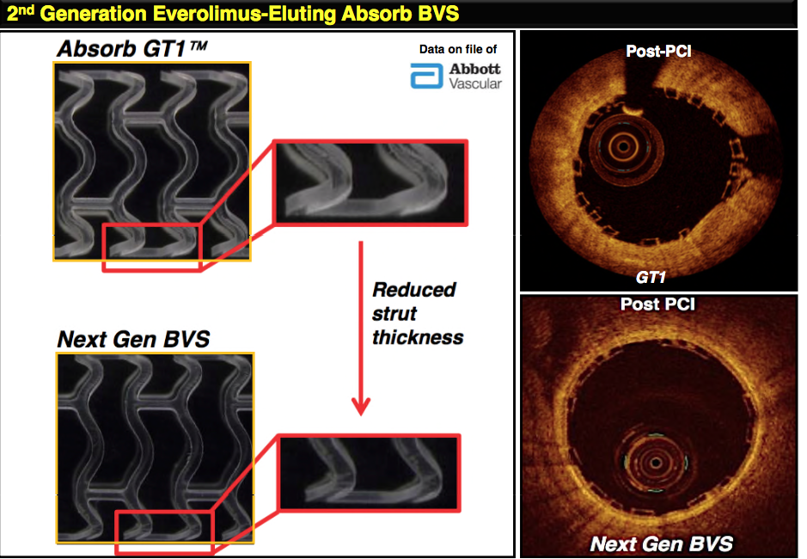

Slide 58
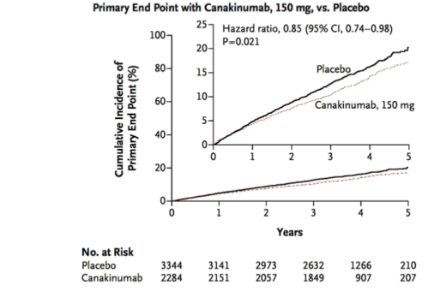

Slide 60
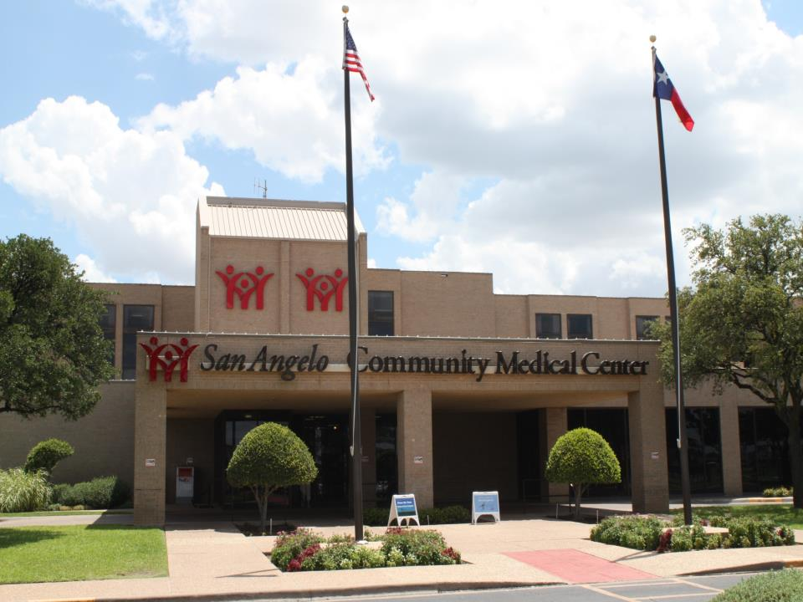

Slide 67
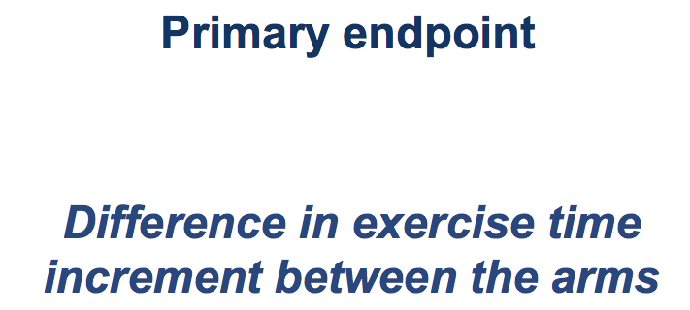

Slide 76
ORBITA in Context
TCT/Lancet
Small Study, 6 wk FU
Placebo effect of aggressive FU
35% pts had nml FFR/iFR
Single vessel disease
Most likely will not change practice

