Slide 1
Electrophysiology Update - 2018
Senthil Thambidorai MD FHRS
Cardiac EP, SACMC

Slide 2


Slide 3
Disclosures
RESEARCH FUNDING - Medtronic, Biotronik, Biosense Webster
CONSULTANT, ADVISORY BOARD OR REVIEW PANEL - Boston Scientific, St. Jude Medical, Medtronic
SPEAKER'S BUREAU - Pfizer, J & J, Biotronik, Zoll Medical, Medtronic

Slide 4
Agenda
- Atrial Fibrillation ablation
- Non- blood thinner options for Stroke
- Leadless pacemakers & Subcutaneous Defibrillators
- Smartphone Diagnostics

Slide 5
Who may need an ablation?
Heart Rhythm Disorders:
Atrial Fibrillation
Atrial Flutter
SVT- Supraventricular Tachycardia
VT – Ventricular Tachycardia
PVC – Premature Ventricular Contractions
These are traditionally treated with medications. If medications fail then we proceed to an ablation procedure.
Some heart rhythm disorders are treated with ablation directly with high success rates.

Slide 6
What is the most common arrhythmia seen in clinical practice?
[1] Atrial Fibrillation
[2] Atrial Flutter
[3] Ventricular Tachycardia
[4] SVT
[5] PVC

Slide 7
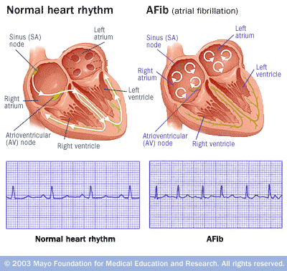
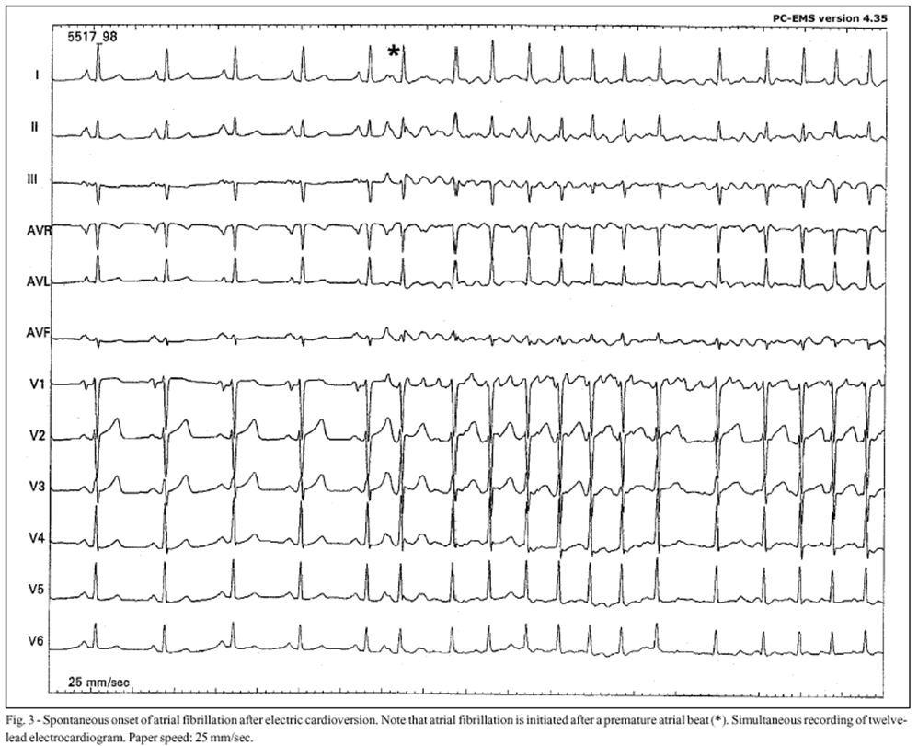

Slide 8
Which Cardiac structure is the most common culprit in Atrial Fibrillation initiation?
[1] Left Ventricle
[2] Right atrium
[3] Mitral valve
[4] Pulmonary Veins
[5] Aorta

Slide 9
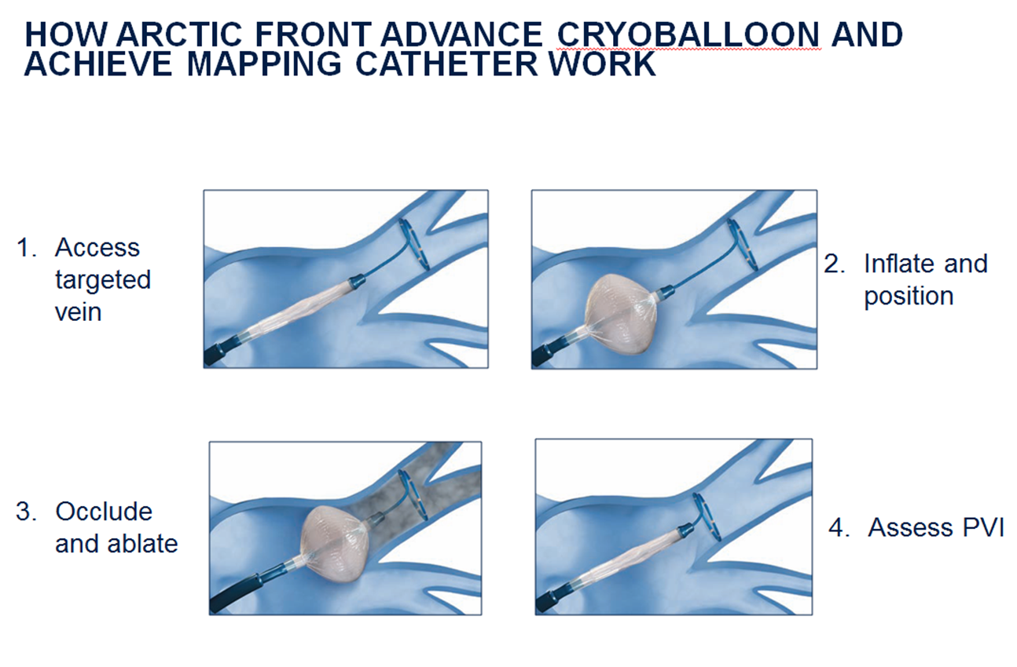
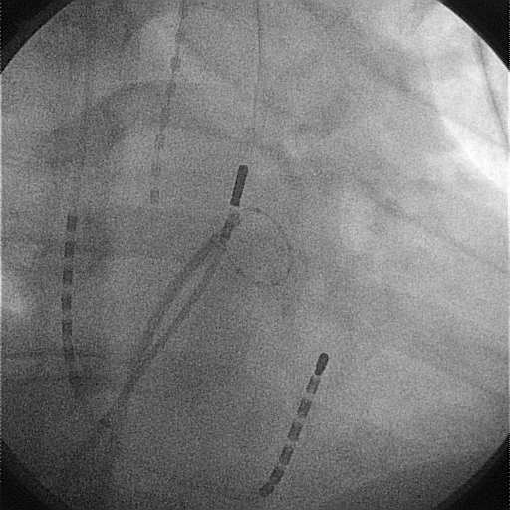
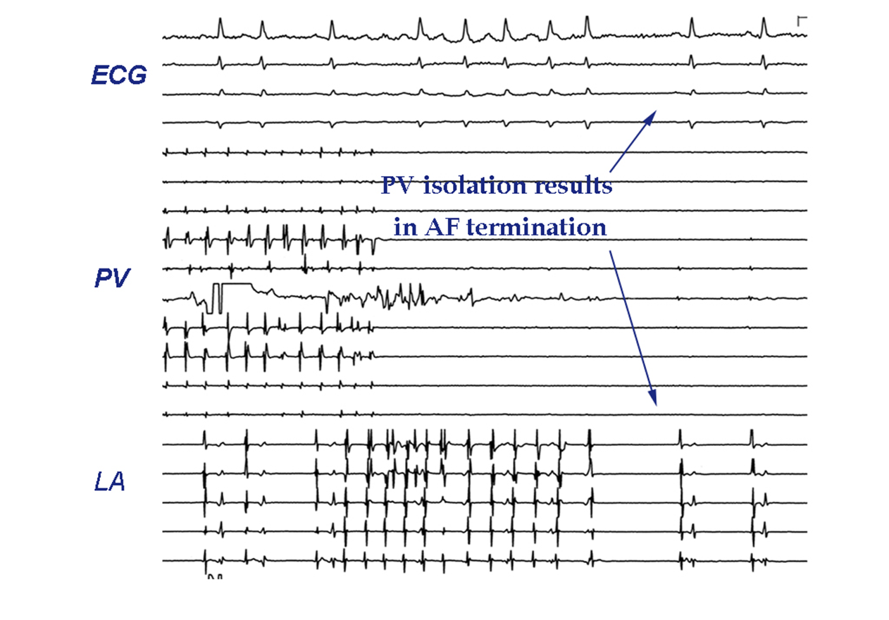
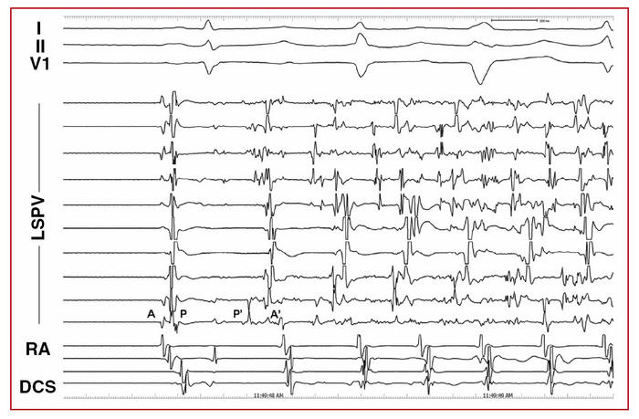
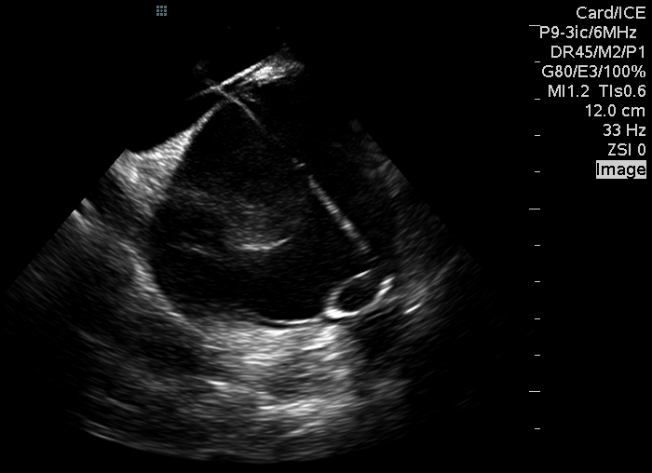

Slide 10
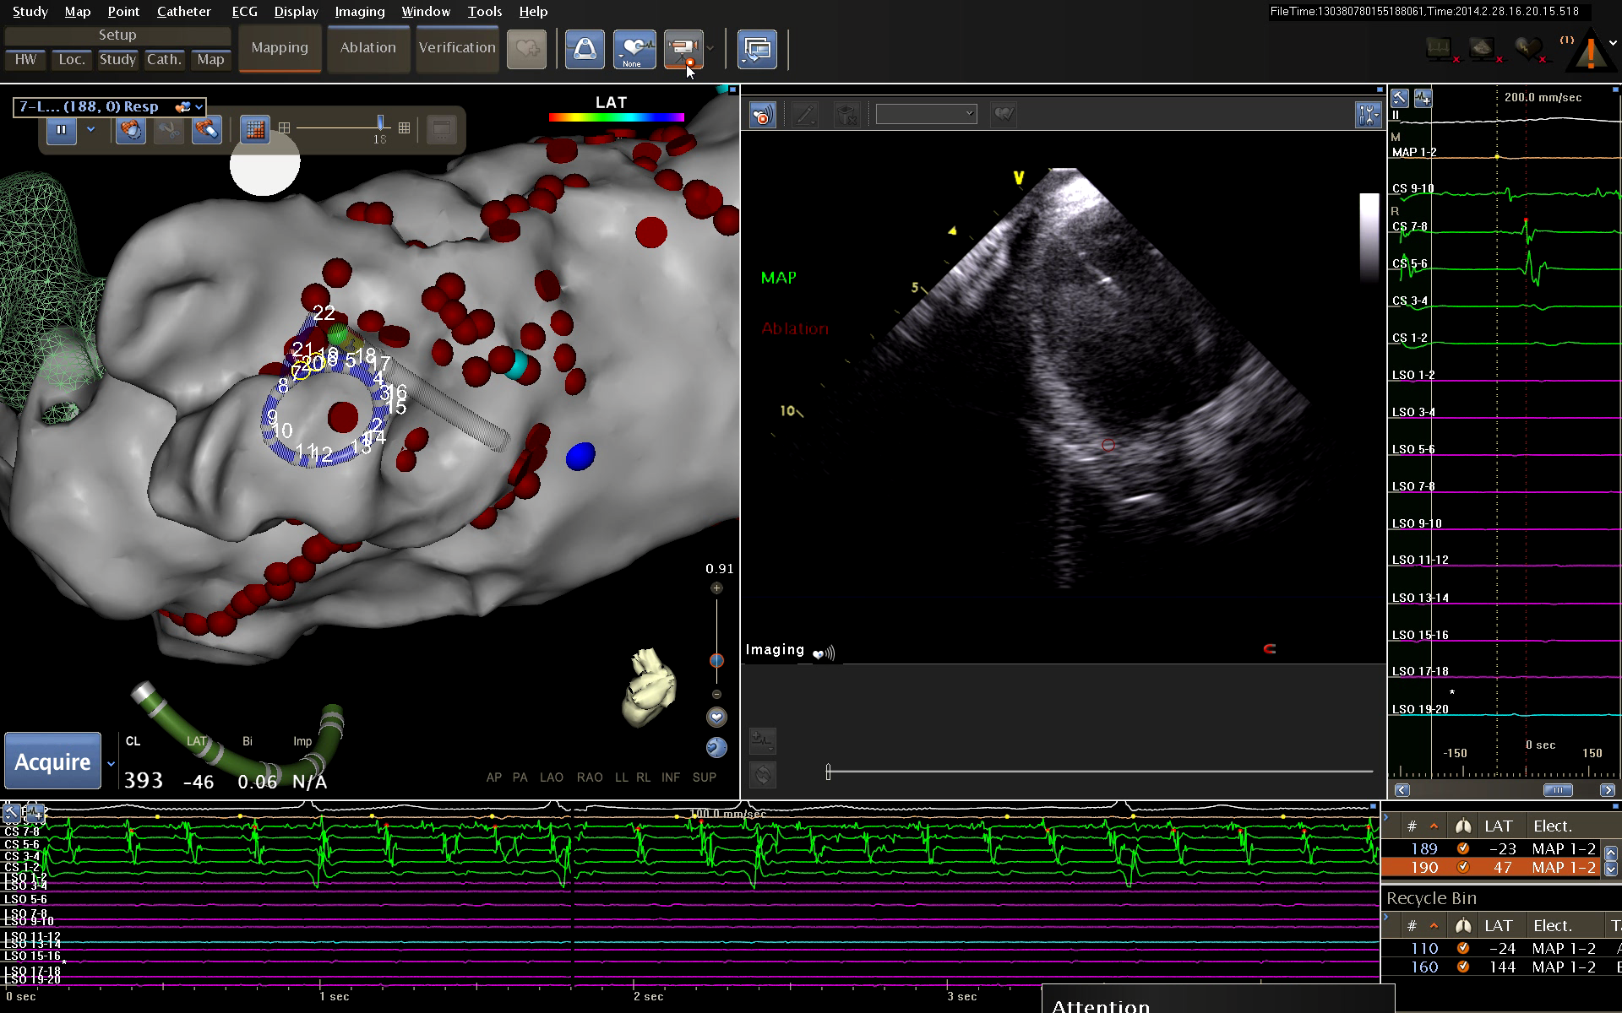
Catheter based Pulmonary Vein Ablation

Slide 11
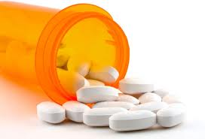
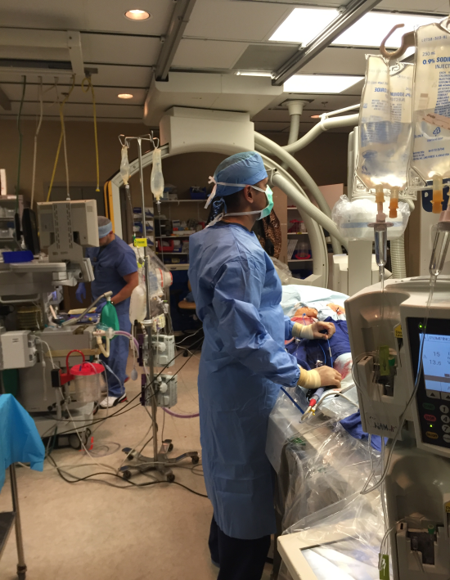
Rhythm Control Strategies
PILLS
ABLATION

Slide 12
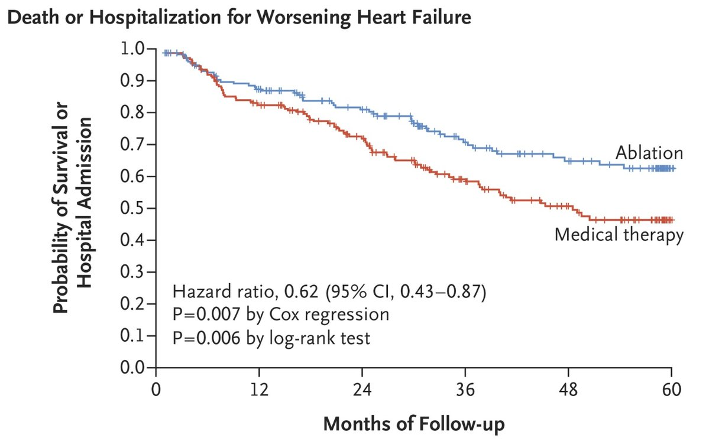
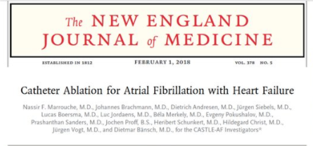
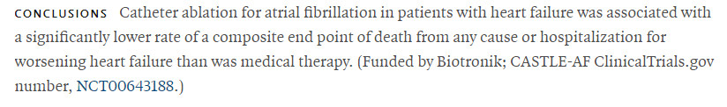

Slide 13
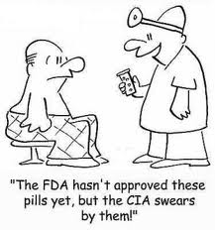
Stroke prevention without medications

Slide 14
Which of these drugs are not adequate for stroke reduction in AF patients with CHADSVASC>2?
[1] Clopidogrel (Plavix)
[2] Warfarin (Coumadin)
[3] Rivaroxaban (Xarelto)
[4] Dabigatran (Pradaxa)
[5] Apixaban (Eliquis)

Slide 15
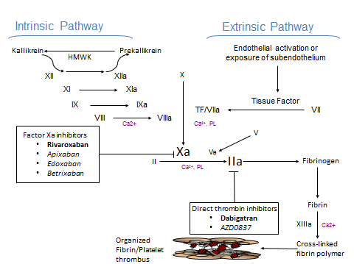
Newer Anticoagulants

Slide 16
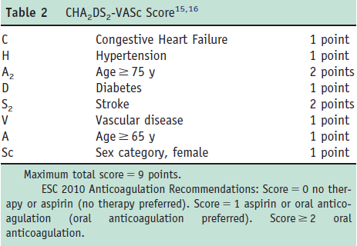
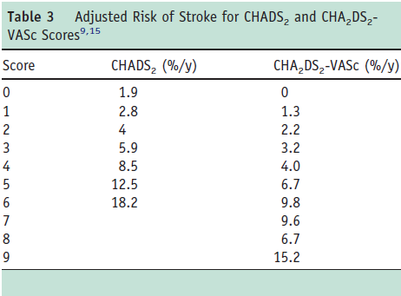
Assessing Stroke Risk

Slide 17
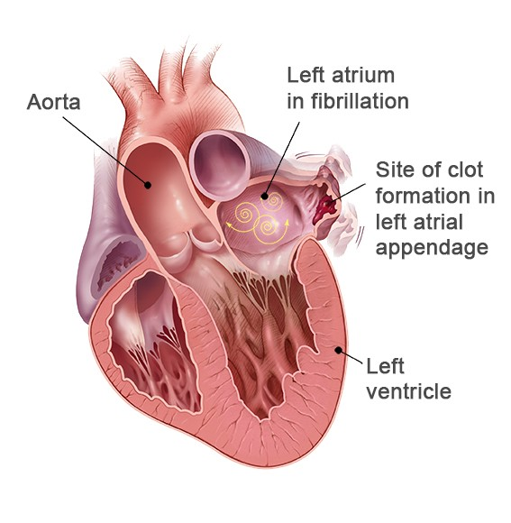
Left Atrial Appendage is the culprit

Slide 18
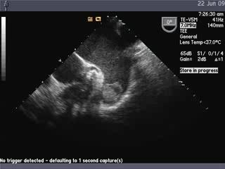
Connection Between Non-Valvular AF-Related Stroke and the Left Atrial Appendage
AF Creates Environment for Thrombus Formation in Left Atrium
Stasis-related LA thrombus is a predictor of TIA¹ and ischemic stroke².
In non-valvular AF, >90% of stroke-causing clots that come from the left atrium are formed in the LAA³.
1. Stoddard et al. Am Heart J. (2003)
2. Goldman et al. J Am Soc Echocardiogr (1999)
3 Blackshear JL. Odell JA., Annals of Thoracic Surg (1996)

Slide 19
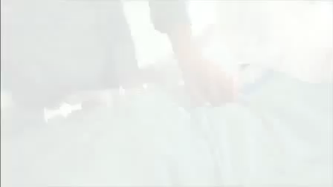
Left Atrial Appendage Occlusion

Slide 20
Most Studied LAAC Device. Only One with Long-Term Clinical Data
 | PROTECT AF | CAP Registry | PREVAIL | CAP2 Registry | Totals
Enrollment | 2005-2008 | 2008-2010 | 2010-2012 | 2012-2014
Enrolled | 800 | 566 | 461 | 579 | 2406
Randomized | 707 | --- | 407 | --- | 1114
WATCHMAN: warfarin (2:1) | 463 : 244 | 566 | 269 :138 | 579 | 1877: 382
Mean Follow-up (years) | 4.0 | 3.7 | 2.2 | 0.58 | N/A
Patient-years | 2717 | 2022 | 860 | 332 | 5931
Source: FDA Oct 2014 Panel Sponsor Presentation.

Slide 21
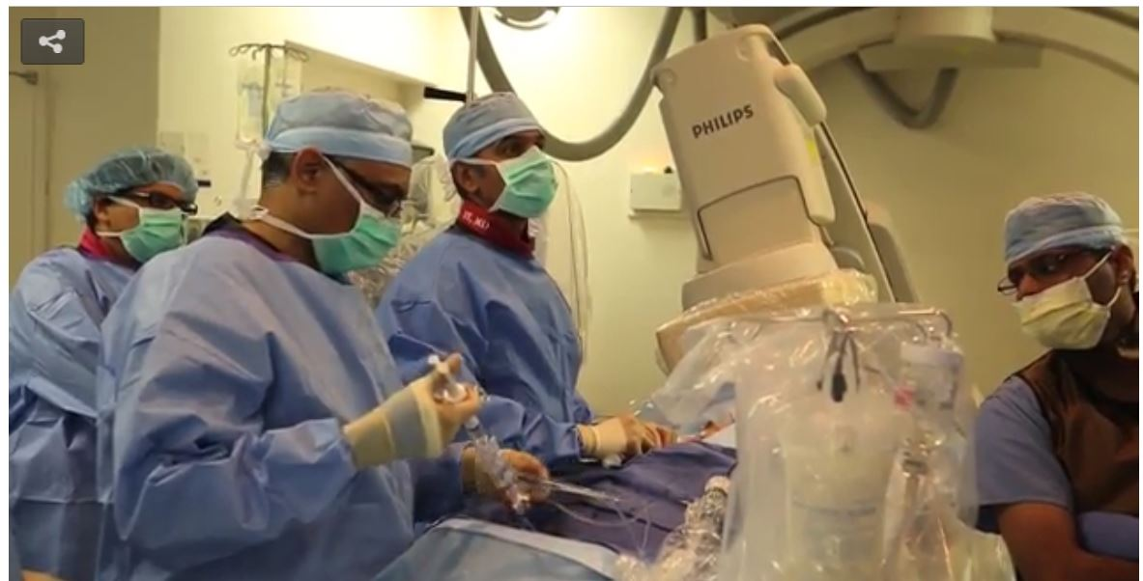
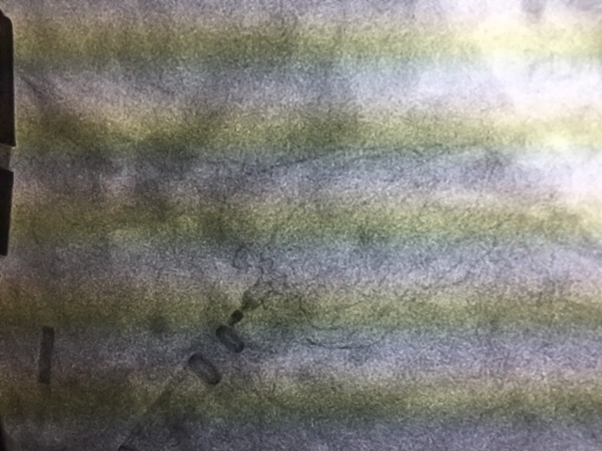
FIRST IN NORTH TEXAS

Slide 22
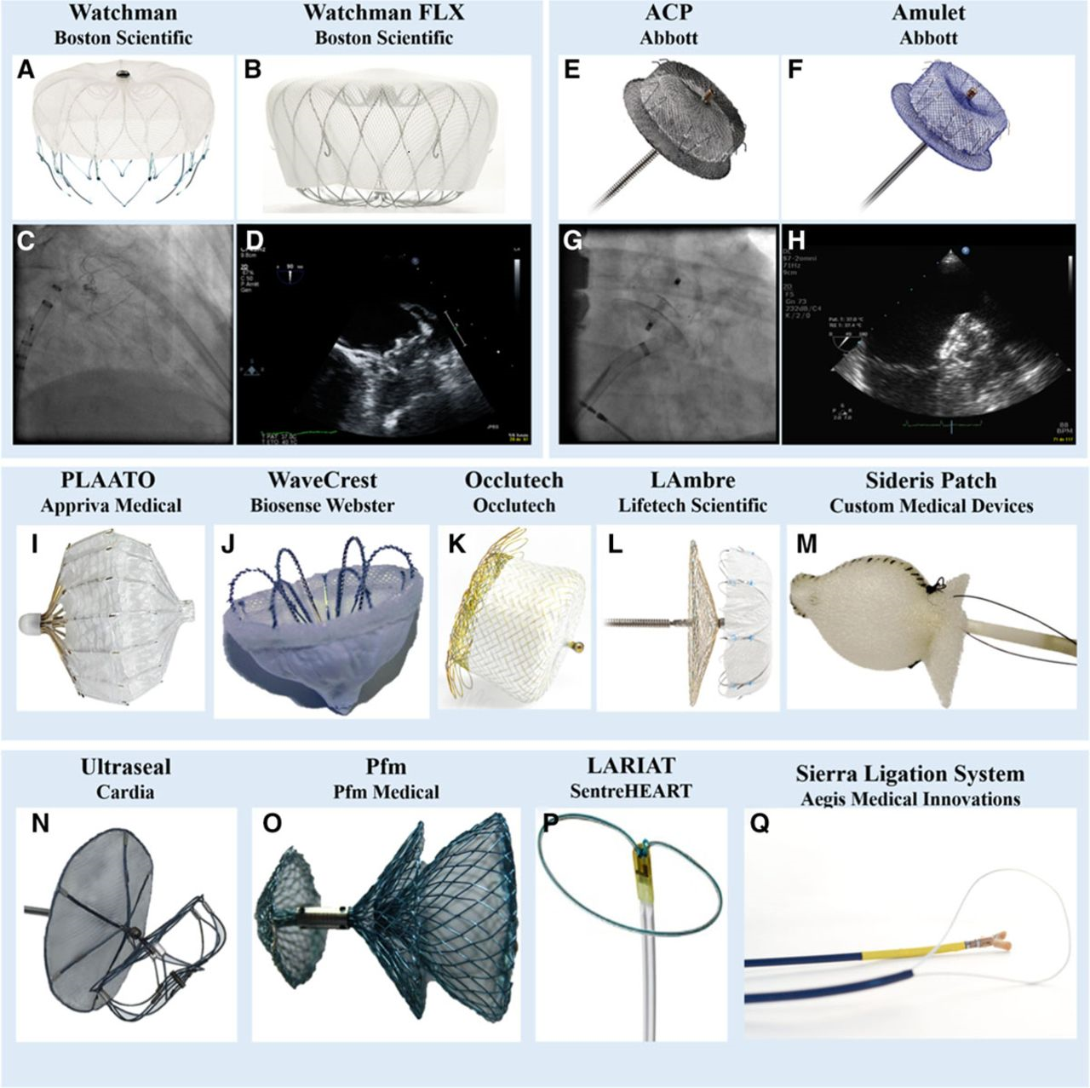

Slide 23

Leadless Pacemakers

Slide 24
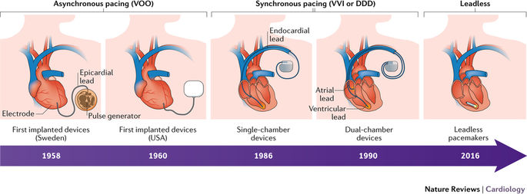

Slide 25
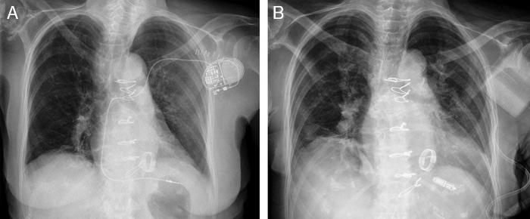

Slide 26
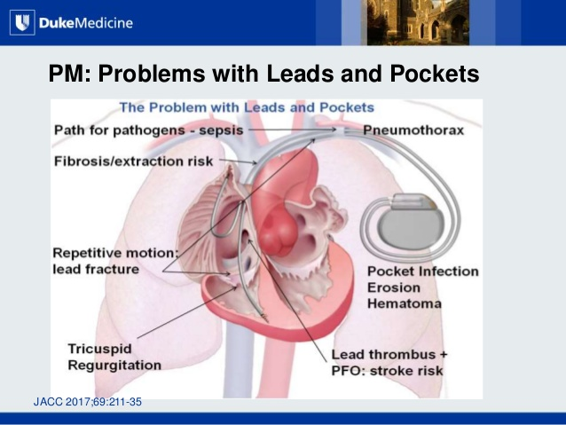

Slide 27
Indications
Single Chamber pacing- Atrial Fibrillation
Patients with complicated venous access- End stage Renal Disease, previous hematoma, venous occlusion
Tachycardia- bradycardia syndrome

Slide 28
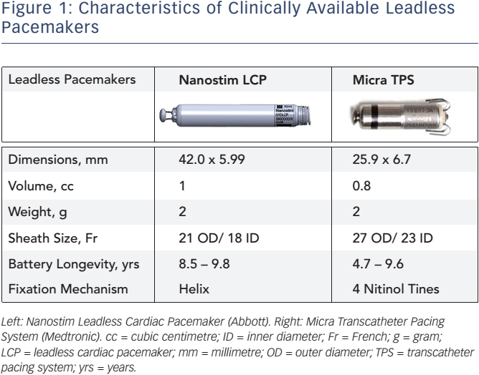

Slide 29


Slide 30
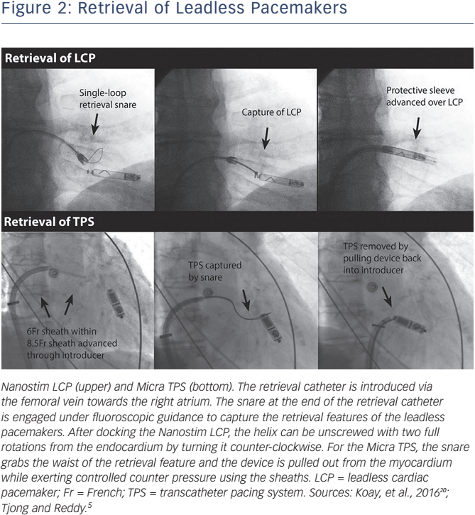

Slide 31
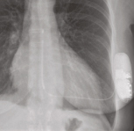
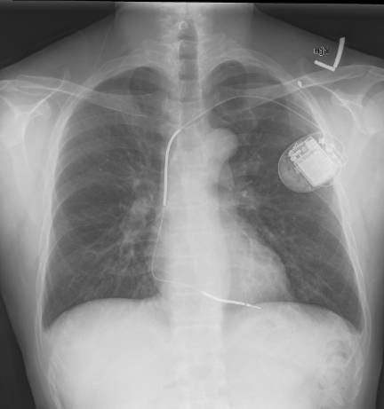
Subcutaneous Defibrillators
“New” Subcutaneous AICD
“Traditional” Transvenous AICD
Reduces risk of lung injury and heart injury during procedure
No hardware inside the heart- No risk of infection spreading
Reduced radiation exposure to patient during procedure (0-1 Xray equivalents in the new procedure vs 5-15 Xray equivalents in the traditional method)

Slide 32
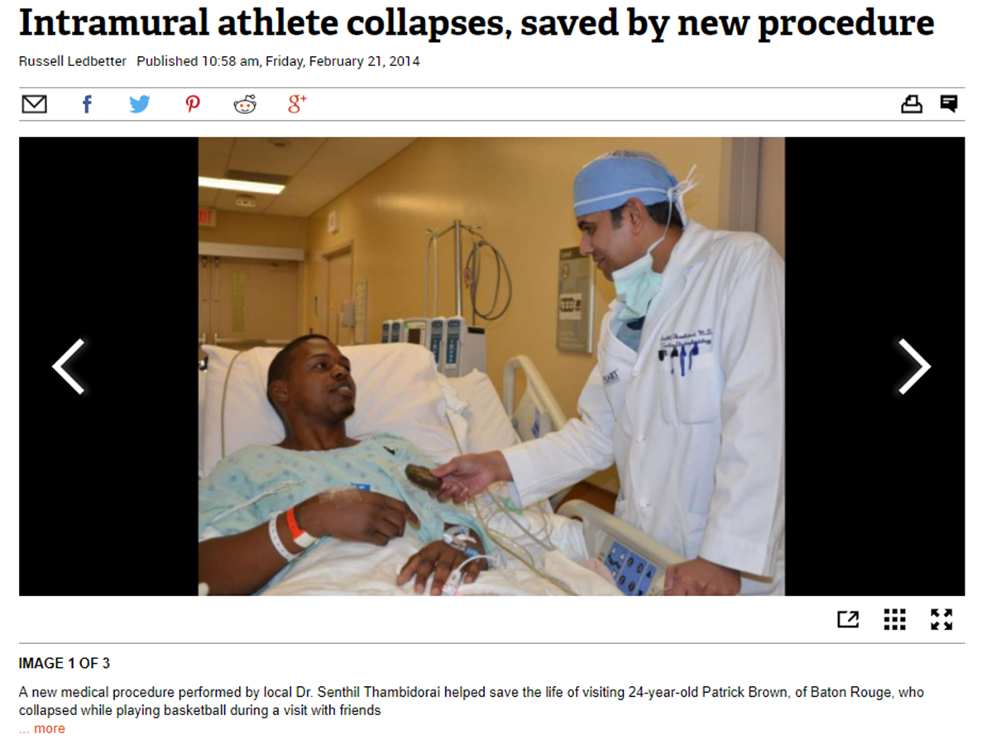


Slide 33
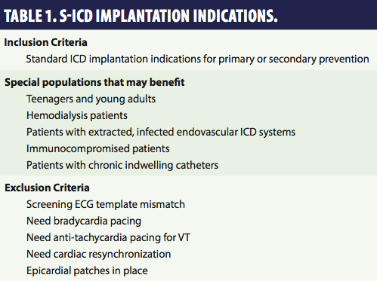

Slide 34
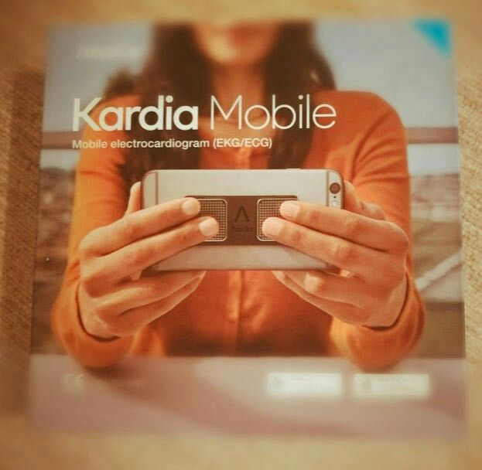
Smartphone Diagnostics
…….BUT FIRST LEMME TAKE A #SELFIE

Slide 35
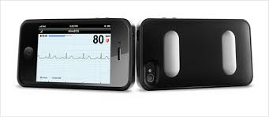
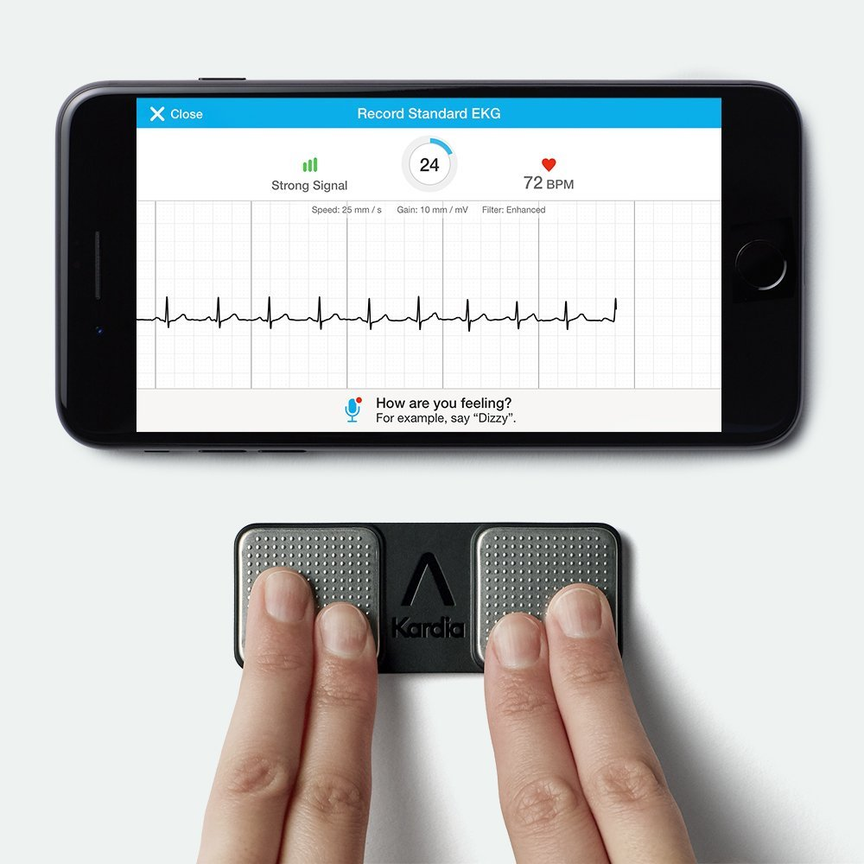
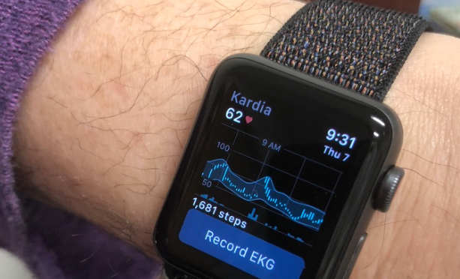

Slide 36
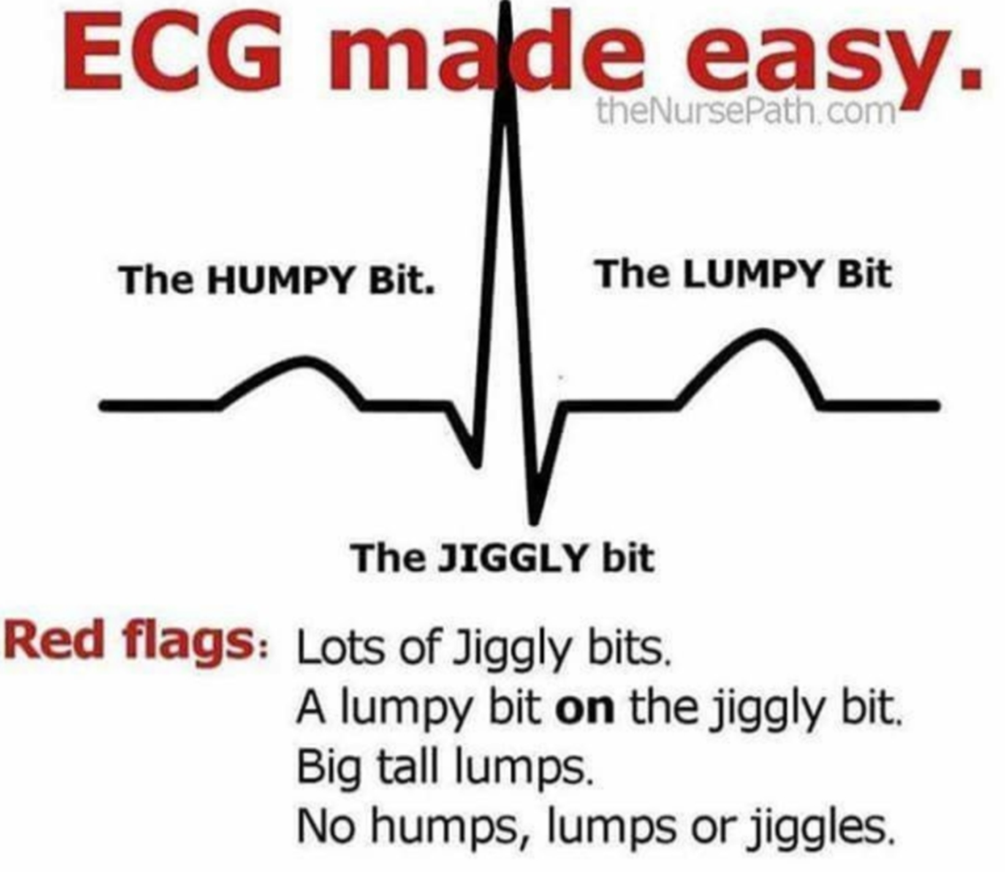
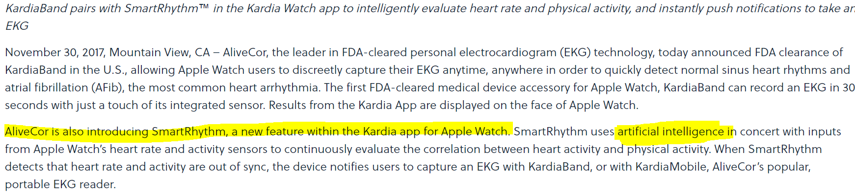

Slide 37
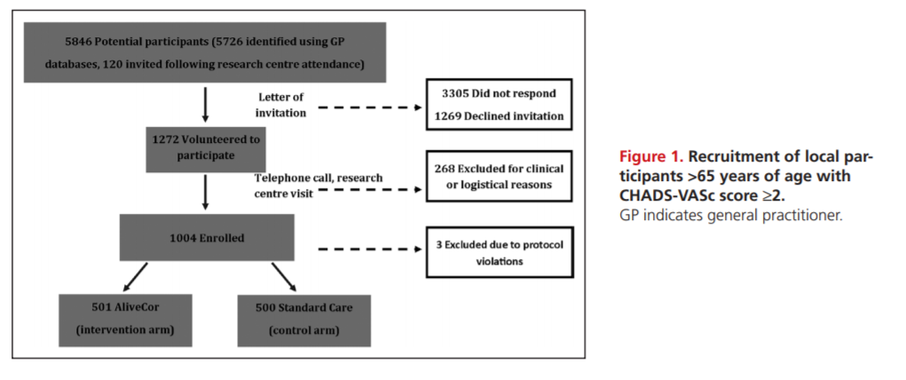
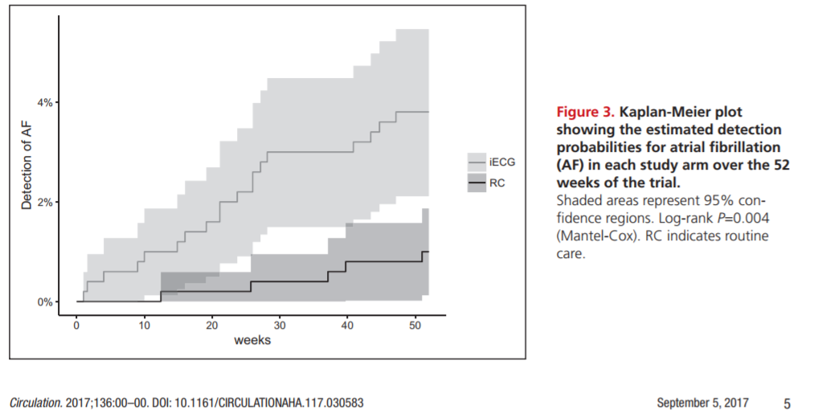
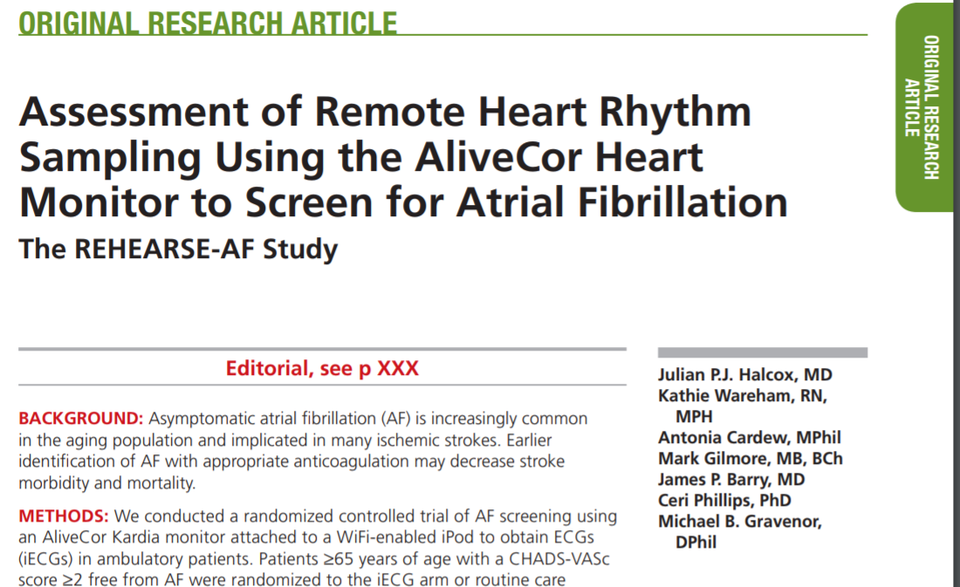
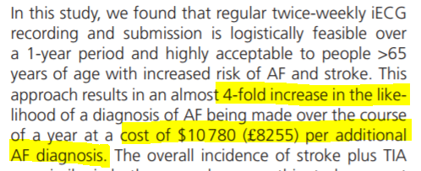

Slide 38
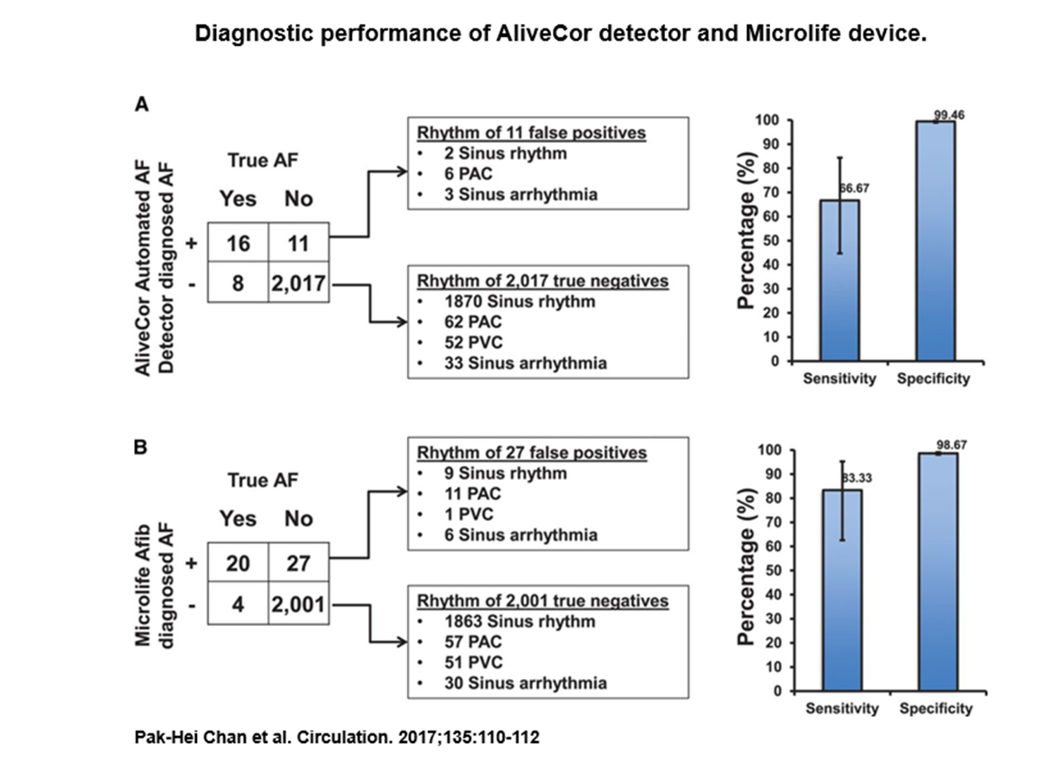
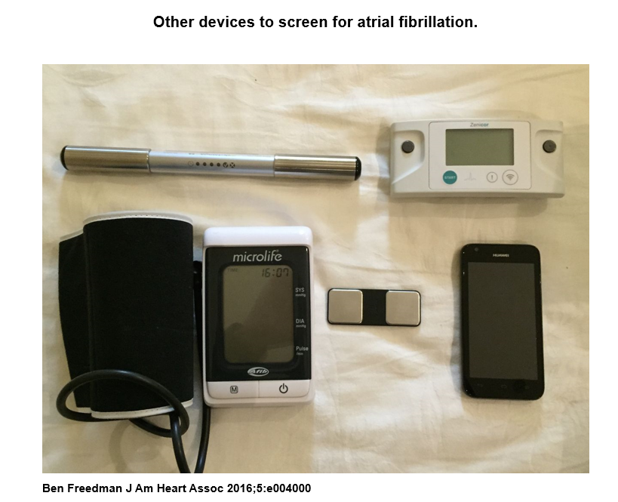
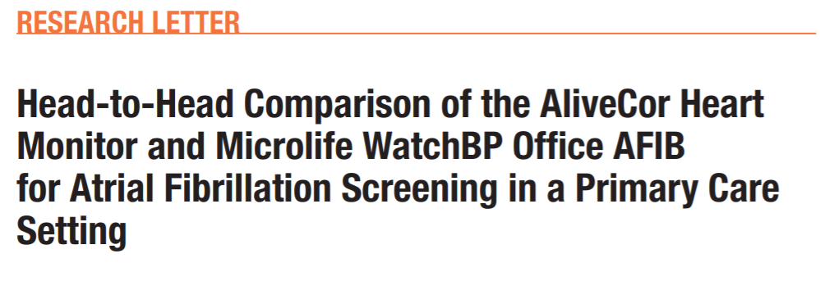

Slide 39
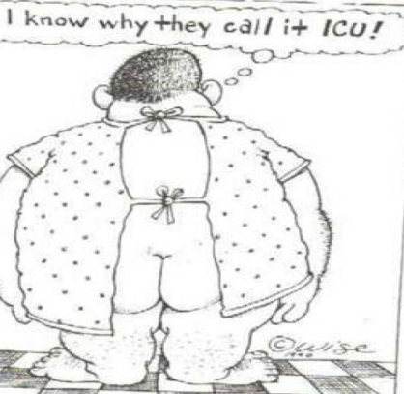
Take Home Points
[1] Ablation is more effective and safer with newer technology and tools and is becoming more first line especially in patients with CHF
[2] Newer options with percutaneous devices as an alternative to Blood thinners
[3] Newer options for pacing and defibrillators
[4] New Smartphone diagnostics may help with AF diagnosis in ‘at risk’ populations- >65 years of age with CHADSVASc>2

Slide 40
