Slide 1
Targeted Temperature Management: Therapeutic Hypothermia after Cardiac Arrest
Jordan S. Weingarten, MD
Medical Director, SMC Austin Adult ICU
Medical Director, SMC Austin Adult ECMO
July 30, 2016

Slide 2
Disclosures
I have no financial interest in any of the products discussed
I may discuss off-label use of medications and devices

Slide 3
Objectives
Define Targeted Temperature Management (TTM)
Discuss the pathophysiology of anoxic brain injury and the rationale for treating with hypothermia
Review national recommendations regarding (and literature supporting) TTM following cardiac arrest
Discuss implementation of TTM in the field, in the ER and cath lab, and in the ICU

Slide 4
Outline
Rationale for Targeted Temperature Management
Data supporting TTM following cardiac arrest
AHA National Recommendations for TTM
How to implement TTM:
Pre-Hospital, ER/cath lab, ICU
Shivering management
Potential complications

Slide 5
Abbreviations
TTM: Target Temperature Management
TH: Therapeutic Hypothermia
CPR: Cardiopulmonary Resuscitation
ROSC: Return of Spontaneous Circulation
AHA: American Heart Association
ED and ER: Emergency Department & Emergency Room
SBP: Systolic Blood Pressure
GCS: Glasgow Coma Scale
OOH: Out of Hospital

Slide 6
Pathophysiology: Old Model
During cardiac arrest, neurological deficits result from decreased cerebral oxygen delivery due to low BP and lack of perfusion
Cell death began after about 4 minutes of anoxia, with damage being irreversible: all or none event

Slide 7
Pathophysiology: New Model
During cardiac arrest, neurological deficits result from decreased cerebral oxygen delivery due to low BP and lack of perfusion
Hypoxic brain causes cerebral edema and failure of synaptic transmissions
Reperfusion can exacerbate cerebral edema, initiate destructive chemical cascades, and alter the inflammatory response with further tissue injury
Result is compromised neurological function after successful resuscitation from a cardiac event

Slide 9
Effects of Therapeutic Hypothermia
Cooling the patient for a period of time, followed by slow rewarming limits the effects of cerebral hypoxia and reperfusion
Hypothermia slows cerebral metabolism (Oxygen consumption decreases by 6% for each degree in body temperature reduction)
Hypothermia limits cerebral cell death and lessens cerebral edema

Slide 10
LOTS of animal data suggesting benefit of hypothermia on mitigating severity of neurological damage following anoxic insult
First good human data published in 2002

Slide 11
“Treatment of Comatose Survivors of Out-of-Hospital Cardiac Arrest with Induced Hypothermia”
Small (77 patients) single city study (4 EDs in Melbourne), randomized, prospective, partially blinded
VF arrest only, coma after ROSC
Cardiogenic shock excluded (SBP<90 on epinephrine)
Women under 50 excluded
Patients cooled to 33º C or target of 37º C
Temperature maintained for 12 hours; rewarmed over 6 hours
Usual care after 24 hours
NEJM 2002; 346:557-56

Slide 12
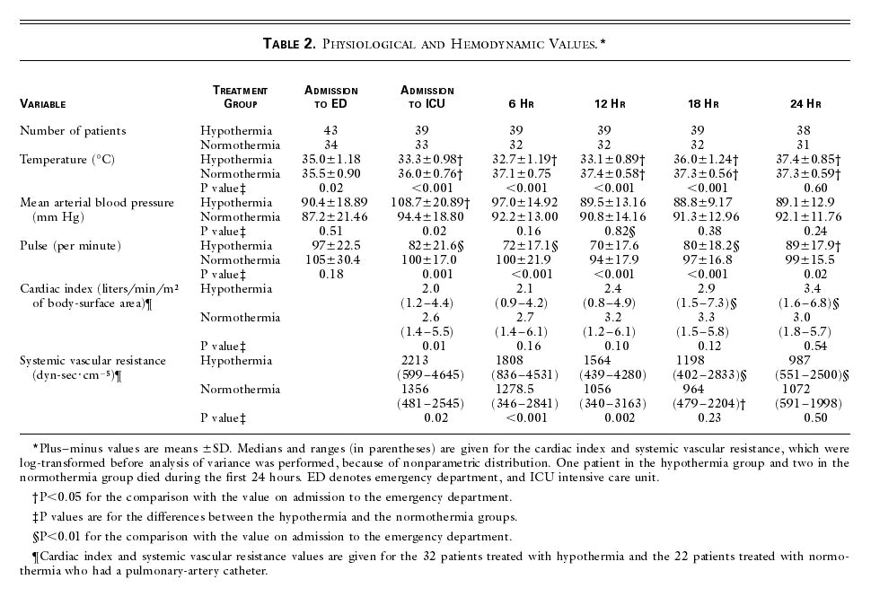
Bernard SA et al. N Engl J Med 2002;346:557-563.
Physiological and Hemodynamic Values.

Slide 13
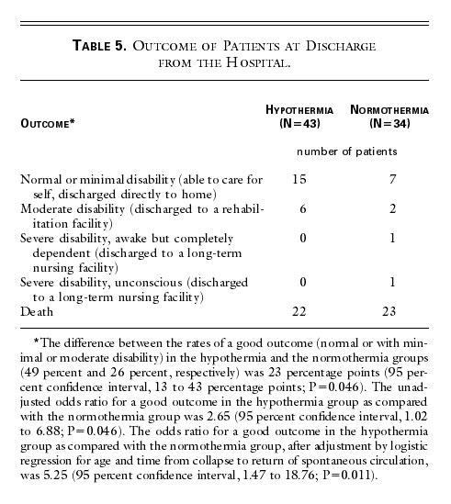
Bernard SA et al. N Engl J Med 2002;346:557-563
Outcome of Patients at Discharge from the Hospital.

Slide 14
“Mild Therapeutic Hypothermia to Improve the Neurologic Outcome after Cardiac Arrest”
Moderately large (275 pts), randomized prospective multi-center study
Witnessed OOH VF or VT arrest
<60 min to ROSC
Multiple exclusion criteria
Target 32-34ºC vs “normal” for 24 hours, followed by passive rewarming
The Hypothermia after Cardiac Arrest Study Group.
N Engl J Med 2002;346:549-556.

Slide 15
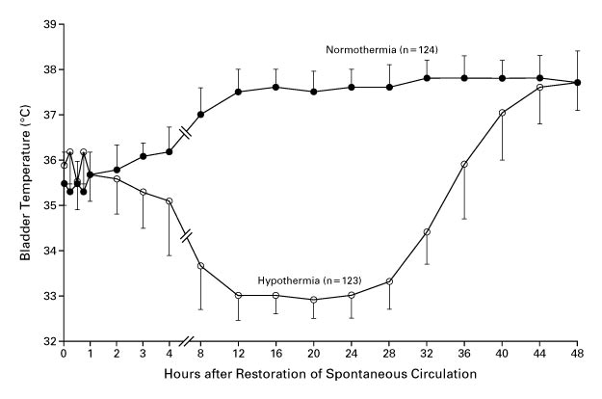
The Hypothermia after Cardiac Arrest Study Group. N Engl J Med 2002;346:549-556.
Bladder Temperature in the Normothermia and Hypothermia Groups.
Notes:
Figure 1. Bladder Temperature in the Normothermia and Hypothermia Groups. The T bars indicate the 75th percentile in the normothermia group and the 25th percentile in the hypothermia group. The target temperature in the hypothermia group was 32°C to 34°C, and the duration of cooling was 24 hours. Only patients with recorded temperatures were included in the analysis.

Slide 16
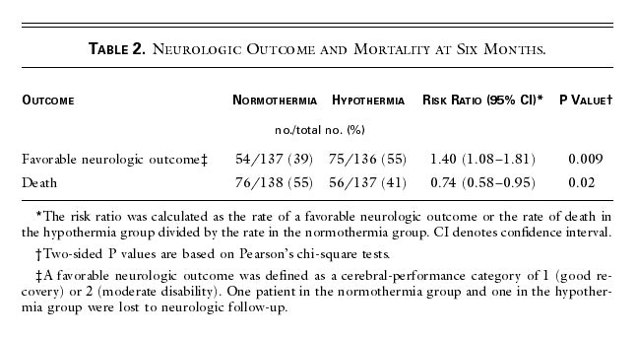
The Hypothermia after Cardiac Arrest Study Group. N Engl J Med 2002;346:549-556.
Neurologic Outcome and Mortality at Six Months.

Slide 17
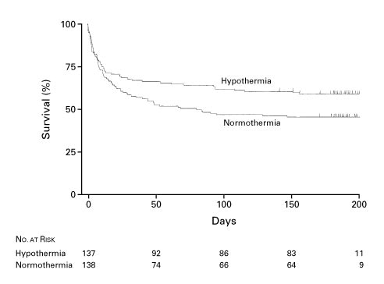
The Hypothermia after Cardiac Arrest Study Group. N Engl J Med 2002;346:549-556.
Cumulative Survival in the Normothermia and Hypothermia Groups.
Notes:
Figure 2. Cumulative Survival in the Normothermia and Hypothermia Groups. Censored data are indicated by tick marks.

Slide 18
Summary of early human data:
Two high quality, randomized prospective studies
Both showed important benefits from hypothermia in carefully selected patients following OOH cardiac arrest
TTM to around 33ºC for 24 hours became “standard of care”
But, lots of unanswered questions:
What about in-hospital arrest?
What about rhythm other than VF or VT?
Is hypothermia important, or is it simply avoiding fever that is critical?

Slide 19
Targeted Temperature Management at 33º C versus 36º C after Cardiac Arrest
Large (950 patients) multicenter (36 ICUs, Europe & Australia), pragmatic prospective, partially blinded, well defined endpoints
To be included, OOH arrest of “presumed cardiac cause, irrespective of the initial rhythm”
20 minutes or more of spontaneous circulation after arrest
GCS 7 or less “not able to obey verbal commands”
Screened within 6 hours of ROSC
Main exclusions: unwitnessed asystole, ICH or stroke, or body temp <30º C
N Engl J Med 2013; 369:2197-2206

Slide 20
Randomized 1:1 to temp 33º C vs 36º C
How to achieve temperature goal at the discretion of individual ICUs
Cold fluids, ice packs, intravascular cooling devices (24%), external cooling pads (76%)
“The choices of sedatives, analgesics and neuromuscular blocking agents were at the discretion of the treating physician”

Slide 21
Intervention period lasted 36 hours
After 28 hours, patients rewarmed 0.5º C per hour until 37º C
After 36 hours temperature kept below 37.5º C until 72 hours elapsed in unconscious patients

Slide 22
Primary outcome was all-cause mortality through the end of the trial.
Main secondary outcome was a composite of poor neurologic function or death, defined as a Cerebral Performance Category (CPC) of 3 to 5 and a score of 4 to 6 on the modified Rankin scale, at or around 180 days.

Slide 23
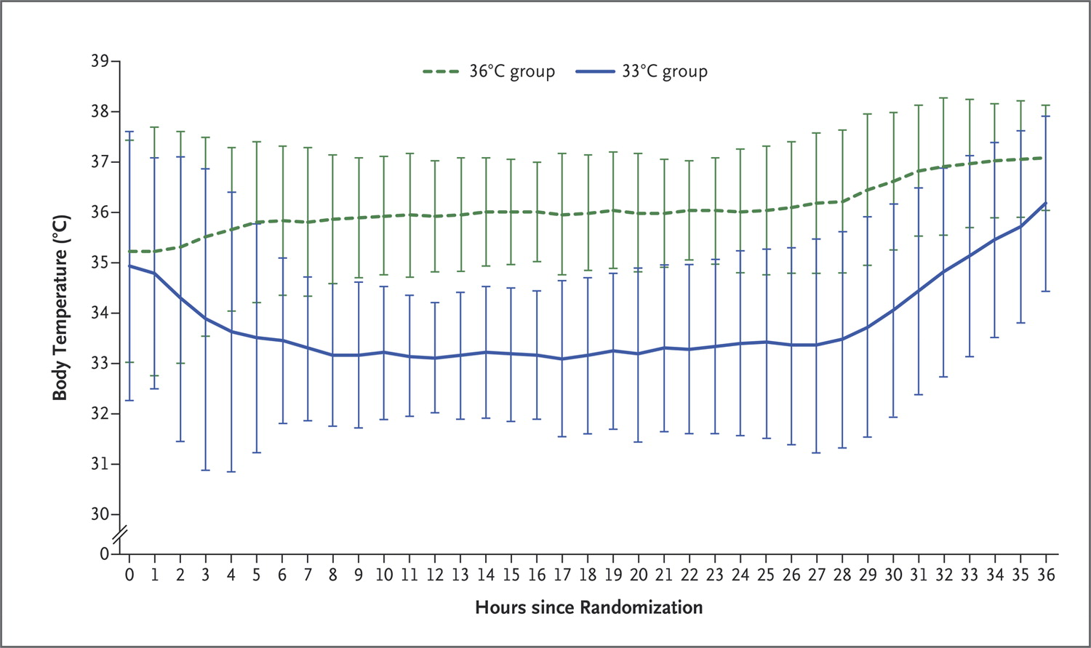
Nielsen N et al. N Engl J Med 2013;369:2197-2206.
Body Temperature during the Intervention Period.
Notes:
Figure 1. Body Temperature during the Intervention Period. Shown are body-temperature curves in the 33°C and 36°C groups for the 860 patients in whom a bladder temperature was recorded. In the remaining 79 patients, the temperature was recorded with an intravascular or esophageal probe, with a similar temperature profile (data not shown). Rewarming was commenced at 28 hours after randomization. The temperature curves display the means, and the I bars indicate ±2 SD (95% of the observations are within the error bars).

Slide 24
CPC (Cerebral Performance Category):
1: good or minor disability
2: moderate disability
Rankin
0: no symptoms
1: no clinically significant disability
2: slight disability
3: moderate disability

Slide 25
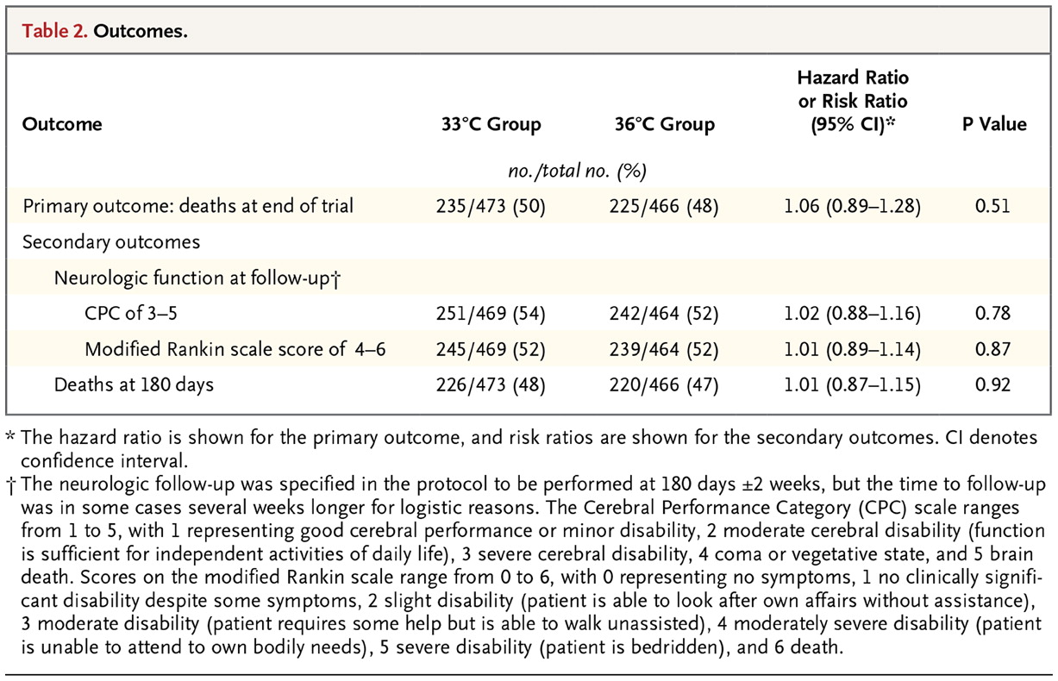
Nielsen N et al. N Engl J Med 2013;369:2197-2206.
Outcomes.

Slide 26
“In conclusion, our trial does not provide evidence that targeting a body temperature of 33ºC confers any benefit for unconscious patients admitted to the hospital after out-of-hospital cardiac arrest, as compared with targeting a body temperature of 36ºC”

Slide 27
Key points:
Older studies randomized patients to hypothermia followed by mild hyperthermia, to mild hyperthermia alone
New study compares a longer period of hypothermia followed by normothermia, to normothermia alone

Slide 28
Key points (continued)
New study less selective inclusion criteria (much more the way we apply it)
Still only looked at OOH arrest
Over a decade between these two studies: the improvement in outcome in the normothermia group might be in part due to other changes in management in the ICU

Slide 29
American Heart Association 2015 Guidelines for CPR and ECC
“All comatose (ie, lacking meaningful response to verbal commands) adult patients with ROSC after cardiac arrest should have TTM, with a target temperature between 32ºC and 36ºC selected and achieved, then maintained constantly for at least 24 hours”
“Actively preventing fever in comatose patients after TTM is reasonable”

Slide 30
Summary so far:
Anoxic injury is not an “all or none” event
TTM following anoxic injury is effective at decreasing the amount of injury that occurs
It is not known if the benefit of TTM is because of cooling, or because of the avoidance of fever
There remains debate about how much to cool; there is very little debate about whether to cool

Slide 31
What about pre-hospital cooling?

Slide 32
Challenges in pre-hospital TTM
Incomplete neurological assessment
Pre-hospital TH performed by EMS may result in longer transport times (additional task)
Cost of equipment and training of EMS personnel
EMS personnel must have access to accurate methods to monitor temperature when inducing TH in pre-hospital setting
Tympanic thermometer devices easy to use, but less reliable than esophageal, bladder, or rectal temperature
Risk of unintentional overcooling (<33°C)

Slide 33
Cold Intravenous Fluids
30 to 40 mL/kg cooled to 4ºC infused over 30 min reduces core temperature up to 2ºC - 2.5ºC
Decreases time to therapeutic temperature (32ºC – 34ºC)
Simple, safe, inexpensive, and effective in lowering body temperature
But, small studies suggested no improvement in outcome at hospital discharge compared with cooling in the hospital

Slide 34
Pre-hospital Cooling
Large (1359 patients) study with OOH cardiac arrest
Randomized, prospective methodology in Washington (State)
Half received up to 2 liters of 4ºC NS immediately after ROSC
All had TTM to <34ºC once admitted
Results:
Temperature decreased by 1.35ºC
Sped up time to reach target temperature of 34ºC by 1 hour
Survival to discharge unchanged
No improvement in neurological outcome
Increased pulmonary edema requiring therapy
JAMA. 2014; 311 (45-52)

Slide 35
American Heart Association 2015 Guidelines for CPR and ECC
“The routine pre-hospital cooling of patients with rapid infusion of cold IV fluids after ROSC is not recommended”

Slide 36
So what should be done before arrival at the hospital?
No guidelines at present regarding pre-hospital TTM other than to NOT use cold IVF boluses to initiate hypothermia
It is reasonable to AVOID warming
It is reasonable to facilitate passive cooling
Remove clothing
Ice packs or similar if available
If IVF needed, cold rather than ambient temperature fluids makes sense
The longer the anticipated arrival time to a center capable of TTM, the more reasonable it is to consider more aggressive cooling measures

Slide 37
Ideal Cooling Device
Rapidly cools the body core to target temperature
System automatically and precisely maintains target temperature
Easy-to-use, multi-functional
“Hands free” operation reduces nursing time
Improved access to patient

Slide 38
Non-Invasive Cooling Options
Ice packs to neck, groin, axillae
Wet, messy, hard to regulate
30-40 ml/kg 4ºC fluid bolus
Partially effective
Cooling blankets or mattress
Automated surface cooling devices

Slide 39
Cooling Blankets or Mats
Manual system with reusable vinyl water blankets
Placed under and/or over patient
Air trapped between blanket and patient acts as insulator, resulting in slow thermal transfer
Challenges
Coverage impedes patient care
No feedback loop making temperature maintenance difficult with high incidence of overcooling

Slide 40
Automated Surface Cooling Devices
Multiple Brands
• Arctic Sun (Bard) • Medi-Therm III (Gaymar) • KoolKit (Cincinnati Subzero Products) • ThermoWrap (MTRE Advanced Technologies) • EMCOOLS Pads (Emcools)

Slide 41
Arctic Sun
Automated temperature control system that provides rapid, precise control for inducing hypothermia and rewarming
Adhesive, hydrogel energy transfer pads (conductive heat transfer)
Temperature controlled water circulates through the pads in response to patient temperature and a preset target temperature
Pads cover 40% BSA (back, abdomen, thighs)
Cooling rate of 1.2ºC per hour
Continuous temperature reading through urinary catheter with temperature probe or esophageal thermometer
Full disclosure: We use this device.
I don’t get paid a penny for talking about it

Slide 42
Arctic Sun

Slide 43
Also, the Arctic Sun
90m long luxury yacht, “concept” only

Slide 44
Invasive/Intravascular Systems
ZOLL Intravascular Temperature Management (IVTMTM)
Automated temperature control system that provides rapid, precise control for inducing hypothermia and rewarming
Cooling device and central venous catheter
NS circulates through a balloon catheter with a textured surface located in the vena cava
Venous blood cooled by direct contact with catheter
Goal temperature achieved in 2-3 hours
Continuous temperature reading through urinary catheter with temperature probe

Slide 45
Invasive vs Noninvasive
Zoll Alsius CoolGard 3000 vs Medivance Arctic Sun
167 comatose cardiac arrest patients
Same post-resuscitation treatment protocol
No difference in survival with good neurologic function at discharge or 12 months
Time of arrest to achieving TH was equal
More hyperglycemia with Artic Sun
More hypomagnesemia with Zoll Alsius
Crit Care Med 2011; 39: 443-49

Slide 46
We prefer surface cooling and use Arctic Sun
Benefits
Can be initiated in ED, cath lab, ICU
Minimal training
Non-invasive; no need to wait for a trained physician to insert
Proven effective
Drawbacks
Cost: initial device, plus disposable pads (various purchasing plans)
Perhaps more shivering

Slide 47
Shivering
Natural defense against hypothermia to generate heat
Impedes the process of inducing or maintaining TH
Shivering increases metabolic rate which may worsen cell injury
During therapeutic hypothermia induction, shivering occurs 34-36ºC, but then diminishes when temperature <34ºC

Slide 48
Bedside Shivering Assessment Scale
0 – None: No Shivering 1 – Mild: Shivering localized to neck/thorax, may be seen only as artifact on ECG or felt by palpation 2 – Moderate: Intermittent involvement of the upper extremities +/‐ thorax 3 – Severe: Generalized shivering or sustained upper/lower extremity shivering

Slide 49
Columbia Anti-Shivering Protocol
Baseline
Acetaminophen 650-1000mg g 4-6h
Buspirone 30 mg q8h
MgSO4 0.5-1 g/hr (goal Mg 3-4)
Mild sedation
Dexmedetomidine up to 1.5 mcg/kg/h OR fentanyl/meperidine
Moderate sedation
Dexmedetomidine AND fentanyl/meperidine
Deep sedation
Propofol 50-75 mcg/kg/min
Neuromuscular blockade

Slide 50
How to cool if you do not have the fancy stuff?
Remove clothing
Turn down temperature of room
Fans
Ice packs
Water mist, damp sheet (PLUS a fan)
BE SURE TO MONITOR TEMPERATURE: easy to overshoot
If you do not have the equipment/experience to go to 33ºC, shoot for 35-36ºC. AVOID FEVER!!!

Slide 51
Potential Adverse Effects of TTM
Suppresses ischemia-induced inflammatory reactions that occur after cardiac arrest with ↑risk of infection (changes in WBC function)
Mild bleeding
Mild acidosis and increased lactate can occur
Diuresis resulting in metabolic and electrolyte disorders (hyperglycemia; K+, Mg+, Ca++ and phosphorus loss)
Shivering (increased O2 consumption)
Bradycardia
Reduced drug metabolism
Pneumonia (up to 50% in some studies)

Slide 52
Other ICU care:
Low tidal volume ventilation strategies if ARDS
Early nutrition as able
Blood glucose 140-180 using validated protocols
Standard DVT prophylaxis
Standard GIB prophylaxis
Standard pressure ulcer prevention techniques
Antibiotic stewardship
Modern transfusion strategies (Hemoglobin < 7 g/dl)
Full access to appropriate specialists, including critical care, nephrology, cardiology, and neurology
2013 study: 15% had severe sepsis/septic shock; 90% had a severe adverse event other than death

Slide 53
Summary
Ischemic brain injury is not an “all or none” event
TTM appears to be able to decrease the severity of ischemic brain injury
Which target temperature to use is still open to discussion
It matters less how TTM is achieved and more that it is actually performed
If you lack automated devices for TTM, targeting a higher temperature (36º C) is highly reasonable
If you are a smaller facility with only occasional patients being managed following cardiac arrest, consider transfer to a higher level of care

Slide 54
Questions and Comments?

